Slide 1
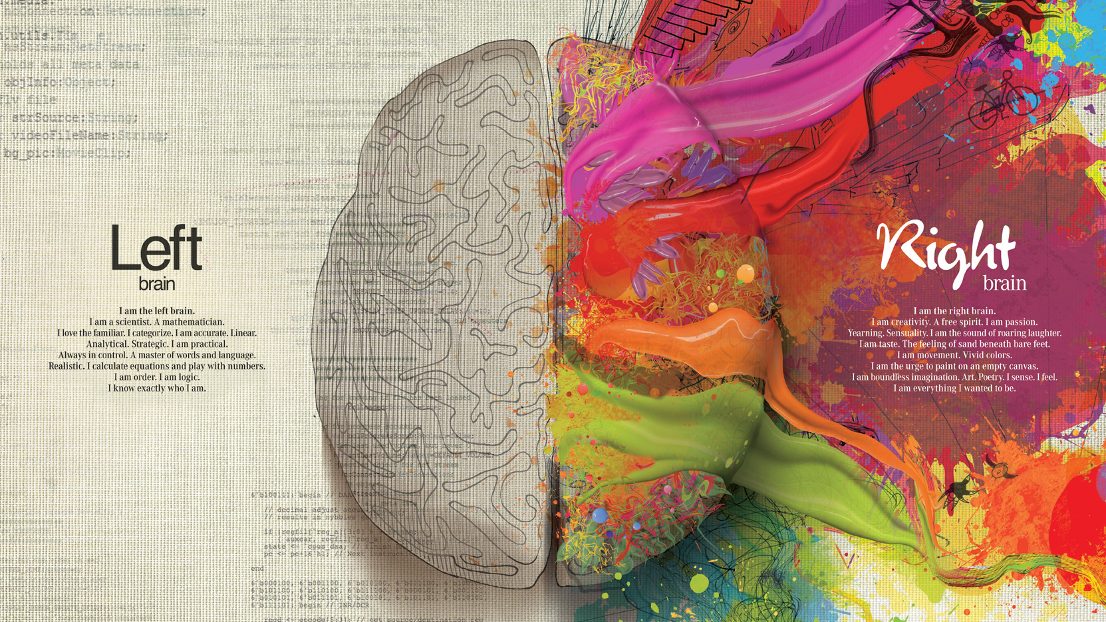

Slide 2
Steven King
Professor of Emerging Technologies

Slide 3




In a particular order
Steven King is a
Christian
The creator God saved my life by sacrificing his son for me.
I serve at Chapel Hill Bible Church
Husband and Father
I have been married 11 years and have two boys, ages 7 and 5. This is my main hobby
Teacher
I want to empower students to be better than I will ever be. This is what I was called to do.
Innovator
I love to solve problems and create new ways of doing things. I am working on my third start up.

Slide 4
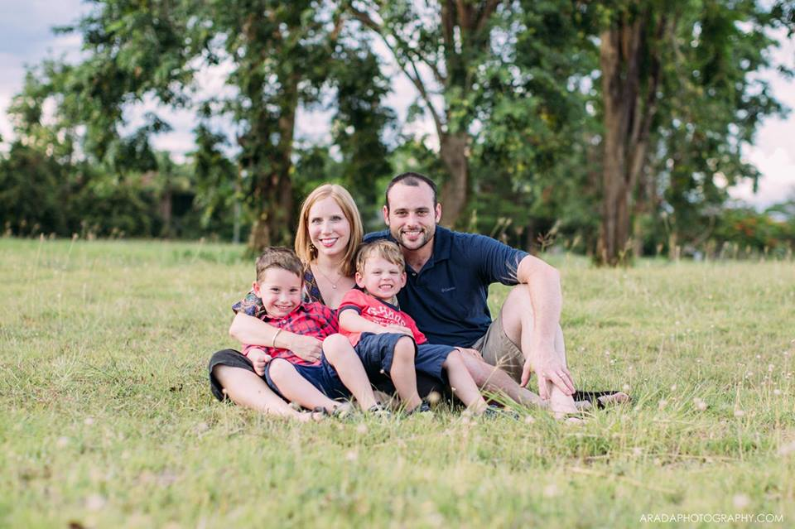
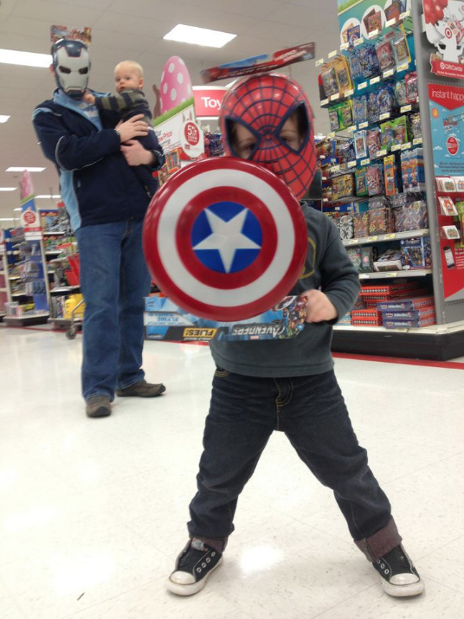
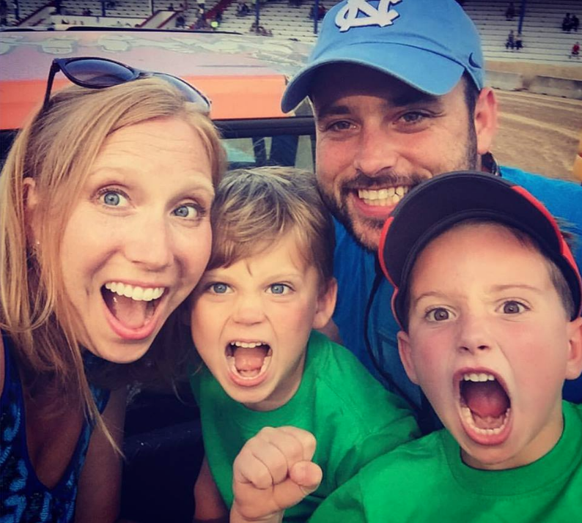
My Family
Amy
Hudson
Rusher

Slide 5
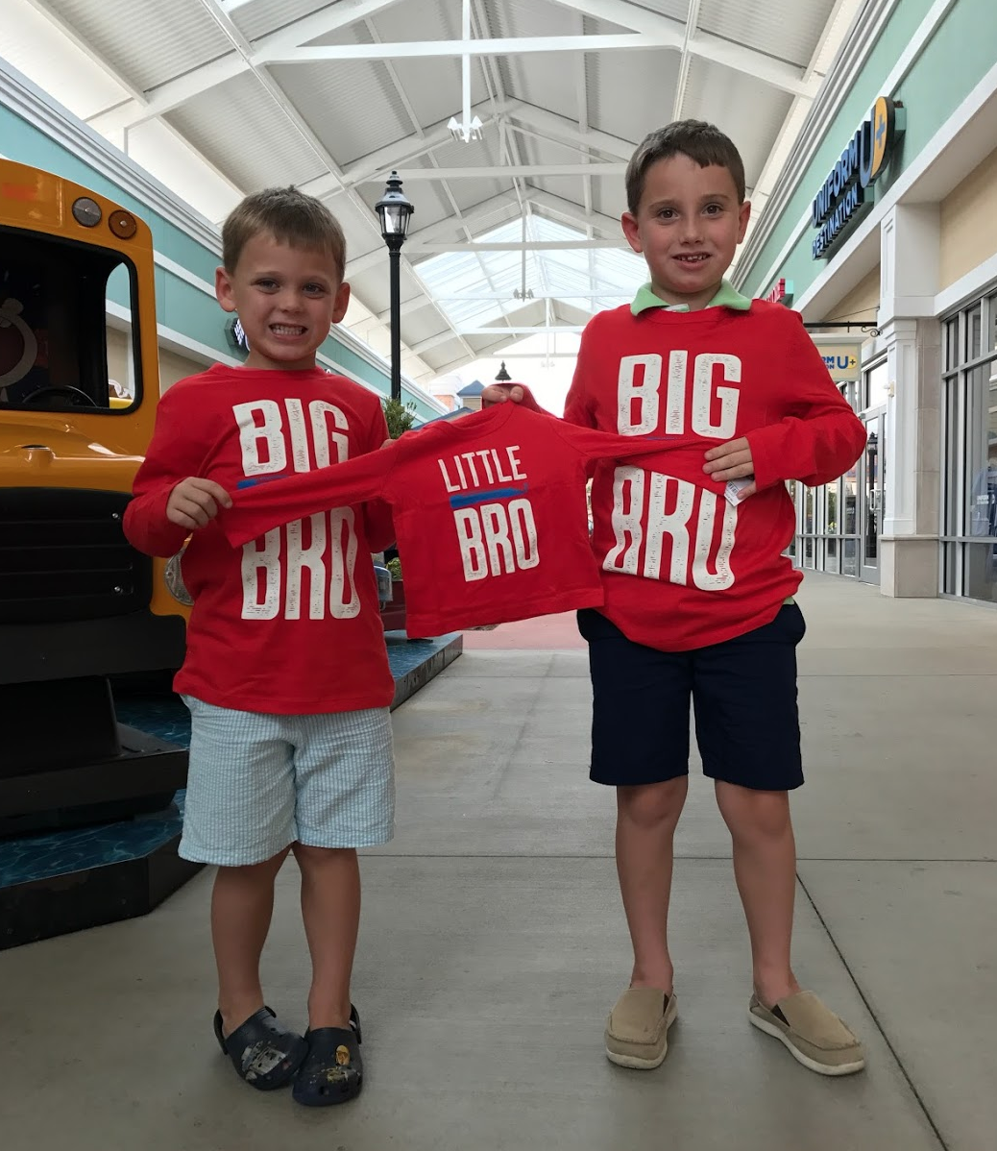
+ 1
Amy
Hudson
Rusher
???

Slide 6
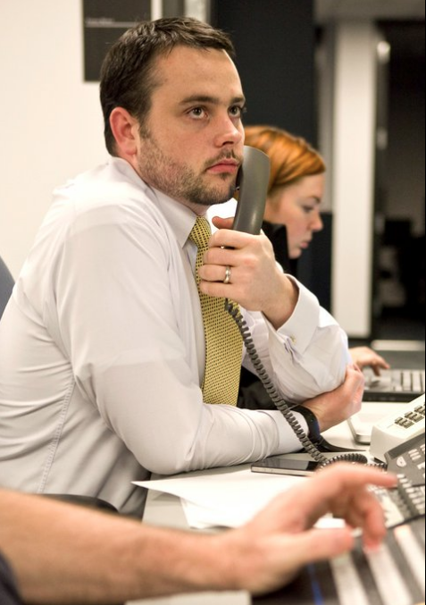
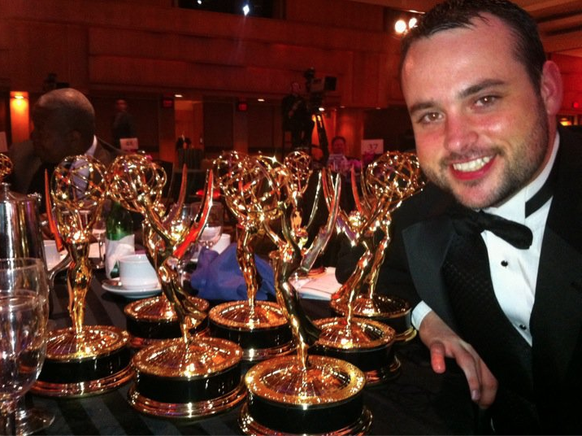
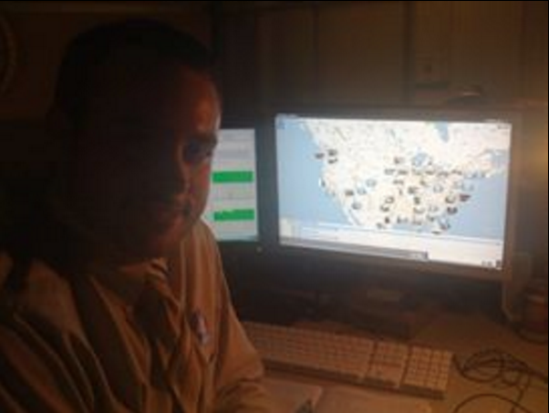
My Career
NBC Olympics
MSNBC.com
The Washington Post

Slide 7
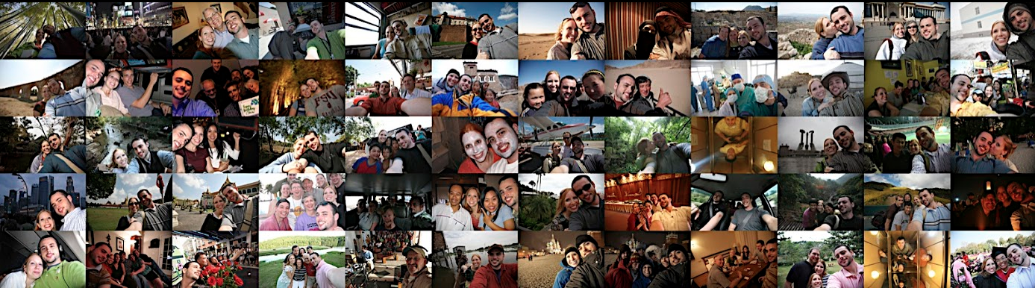
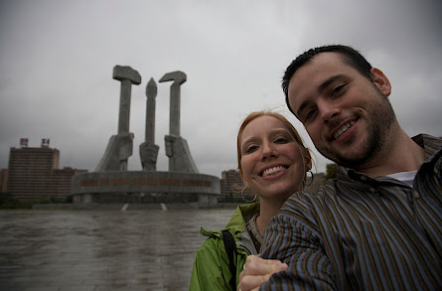
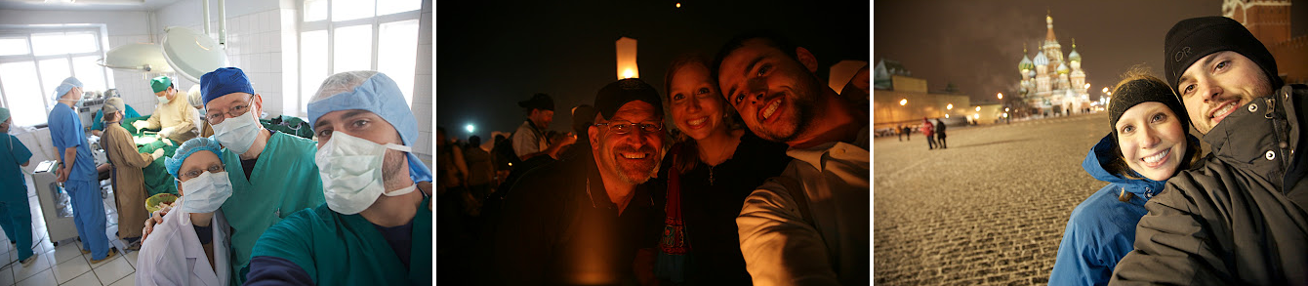

Slide 8
What’s Next
VR, AR, Ai, Robots, Drones, etc.

Slide 9
I hope to teach you
Learning Objectives
Learn to Learn
I can’t teach you everything, you will have to figure a lot of things out on your own
Adapt and Learn
Things change. Figure it out and lead the change.
Create Greatness
Don’t settle for average. Do everything to be great
No Excuses, No Bragging
Don’t make excuses, find solutions and let others discover how great you are.

Slide 10
I hope to teach you
Contact
stevenTking.com
steven-king
@steven_king
steven.king@unc.edu
919-360-8907

